Slide 1
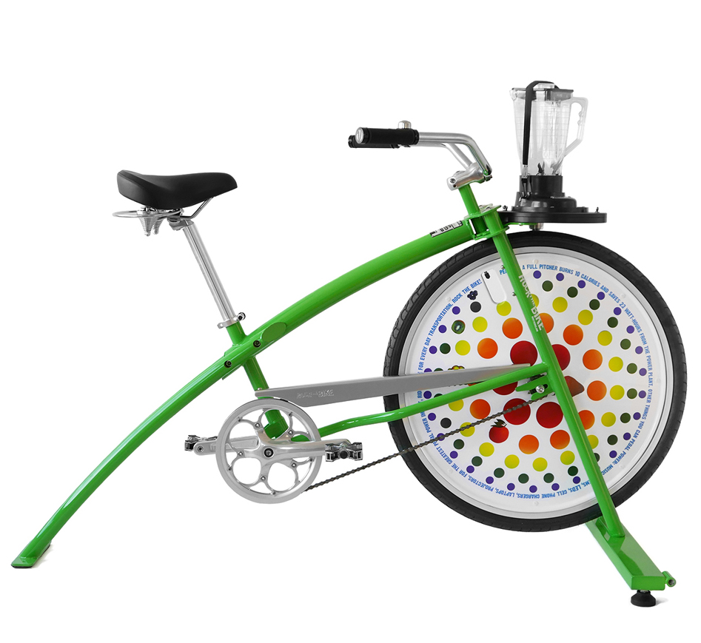
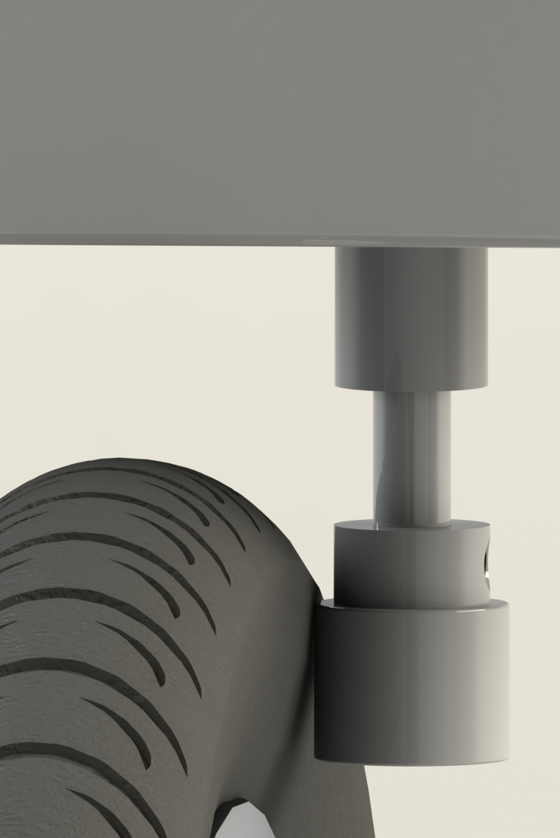
E4
MECH325 Assignment 2 - Bike-Powered Blender
Team E4: Amran Osman, Friend Prakitpong, Gianni Co, Hassan Iqbal, Husein Alatas, Ricky Asfour, Steven McCulloch
November 28th, 2019
Key features
Make your favorite smoothies, shakes, margaritas, or baby food while exercising
Strong enough to crush vegetables, fruits, and ice easily
Can even be used by kids
Totally human-powered
Zero emissions and minimal noise
Parts Used:
Product Name | Part | Vendor | Cost ($)
Blendin Complete 64 oz Jar | Blender jar | Amazon | 54.99
Neoprene Roller Drive, 1/2" Roller Width | Drive roller | McMaster | 22.26
32 Tooth Sprocket | Driving Sprocket | BikeBerry | 19.07
Economy Plus #40 Roller Chain - 10ft Box | Chain | USA Roller Chains | 16.9
Stainless Steel Ball Bearing (R144-2Z) | Roller Bearing | McMaster | 7.19
11 Tooth Freewheel Sprocket | Driven Sprocket | Amazon | 6.69
Rotary Shaft | Shaft | McMaster | 4.85
Calculations:
Chain Length
Center-to-center distance: 16.5”
Pitch: 0.5”
Driving Teeth: 32
Driven Teeth: 11
Plug-and-chug the formula... 43.9” (88 links)
Roller Diameter
Overall Gear ratio: 1:125
Sprocket ratio = 11:32 = 1:2.9
Remaining ratio : 125*11/32 = 42.97 ≈ 1:43
Bike tire diameter = 27.6”
Roller diameter = 27.6/43 = 0.64” ≈ 5/8”
Source: https://rockthebike.com/fender-blender-pro/
Approach
Specify average and maximum input power
Specify the input RPM and blender RPM
Find the gear ratio between sprockets
Find the gear ratio between tire and roller
Find # sprocket teeth, wheel diameter
Calculate roller diameter
Find the required contact area between bike tire and roller to achieve no-slip.
Specify height of roller based on the roller diameter and contact area.
Specify the chain by referring to textbook
Specify roller-to-blender-jar connection
Final Parameters:
Average Input Power | 100 W
Average Input Speed | 100 rpm
Output Speed | 12500 rpm
Output Torque | 0.076 N-m
Effective Gear Ratio | 125:1
ANSI Chain Number | 40
Assumptions:
Design factor: 1.5
(input power unlikely to be >100 watts)
Service factor 1.3 (moderate shock)
No slipping between the tire and the rollers
No slipping between the sprocket and rollers
Negligible chordal speed variation with respect to the bike chains

